Slide 1

MOVIE PRODUCTION ANALYSIS

Slide 2
BUSINESS OVERVIEW
Big companies are creating original videos content; the company wants to start film creation to .
Area of interest is creating movies studio
They want to know which kind of movies to create

Slide 3

BUSINESS UNDERSTANDING
The company now sees all the big companies creating original video content and they want to get in on the fun.
They have decided to create a new movie studio, but they don’t know anything about creating movies.
You are charged with exploring what types of films are currently doing the best at the box office.
You must then translate those findings into actionable insights that the head of your company's new movie studio can use to help decide what type of films to create.

Slide 4
BUSINESS PROBLEM
As technology improves big companies have gone into creating original video content.
This creates a gap for competition and to keep up ,the company has decided to create a new movie studio ,however the bigger challenge is the company lacks appropriate information on movies creation.
The company wants to know which movies to create.
We must explore what types of movies are currently doing well at the box office? and then translating those findings into actionable insights that the head of the company's new movie studio can use to help decide what type of films to create.

Slide 5

which movies should the company create?
To answer this Question, the following have been considered.
What genres are most profitable?
Which movies are most popular over time?
Which category of movies is declining /growing?
What is the recommended runtime for movies created?
How is production budget affecting profits?
How is profit affected by runtime?

Slide 6
DATA UNDERSTANDING
For this project various datasets were provided.
Based on the area of focus, I analysed each dataset and picked 2 which satisfied my questions.
IMDb movie dataset and tn.movie_budget.csv dataset.
The IMDb dataset which is the database information of the movies .The table of interest was movie basics and movie ratings ,primarily focused on movies information with a total of 65720rows * 8 columns after cleaning and merging.
The tn.movie_budget.csv focused on the numbers such as worldwide gross, with a total of 5782 rows and 6 columns after cleaning.
After merging the datasets, the key area of interest was:
Genres
Runtime
Production_budget
Profit(calculated field)
Release years
Ratings
Worldwide gross

Slide 7
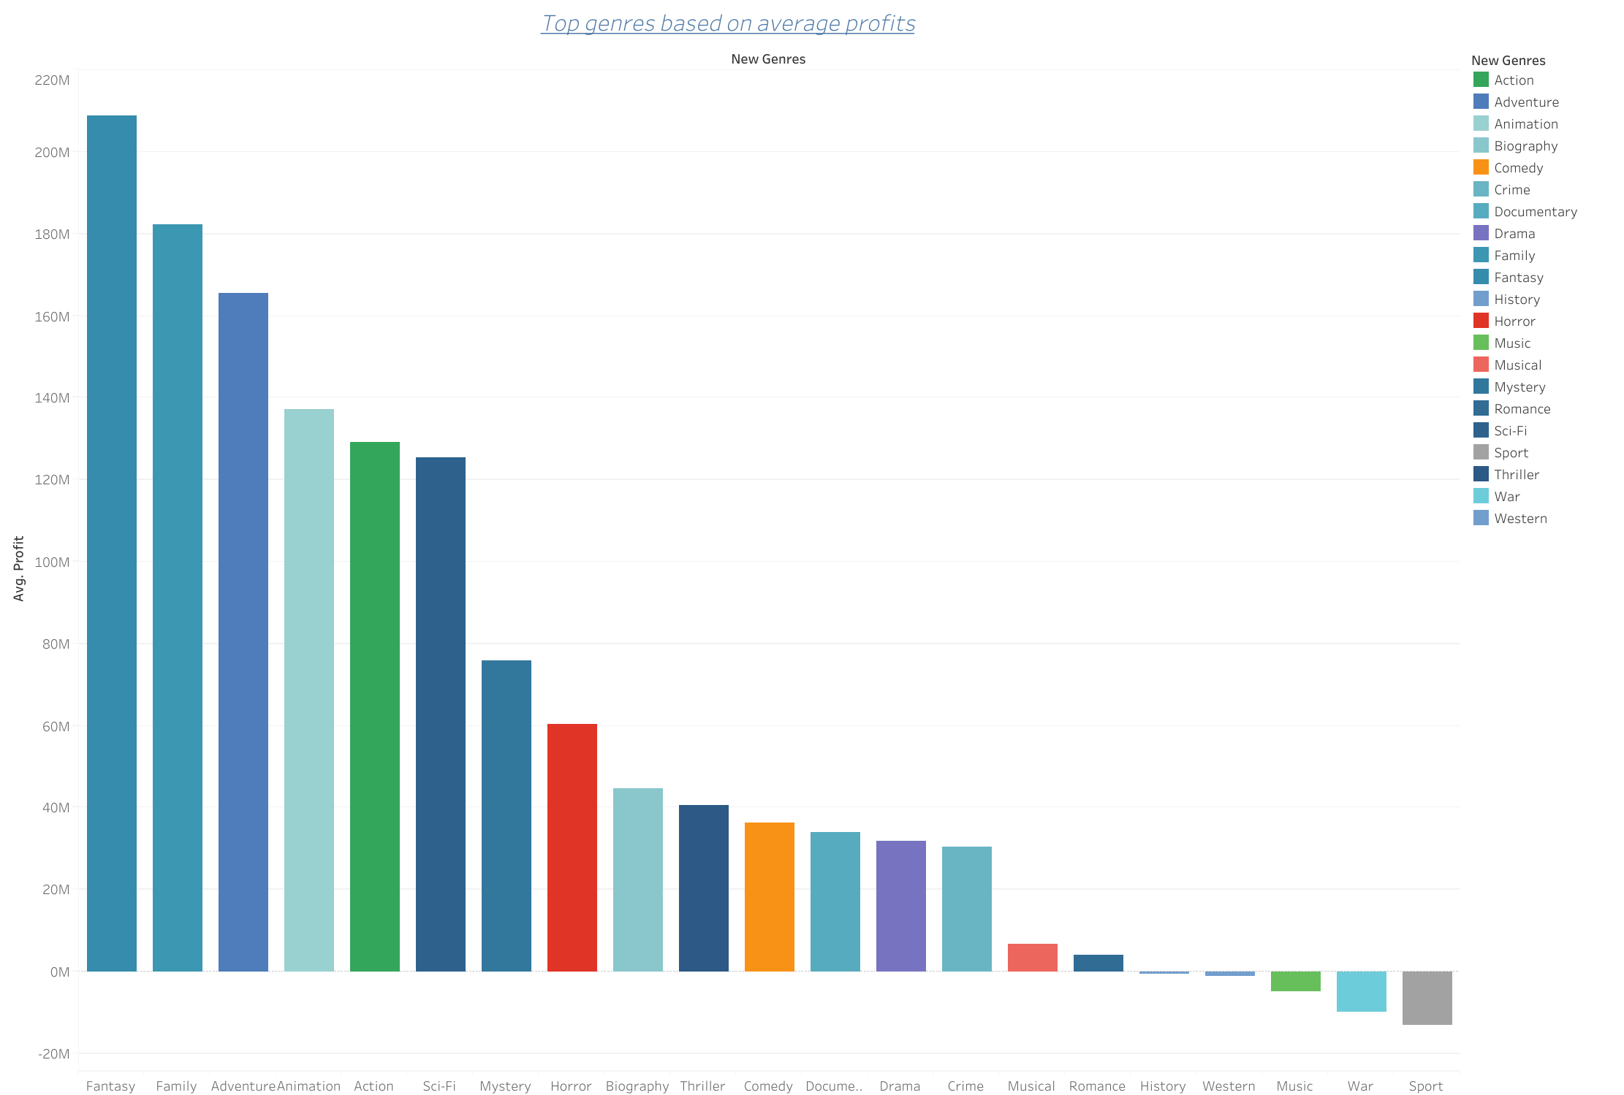
TOP GENRES
Form the various genres Fantasy stood out in having the highest average profit of 208,985,888.
The second is Family, Adventure and animation ,each having an average profit of over 120M.
While sports having an average loss of 13,254,494.
War also having a loss of 9,800,895.

Slide 8
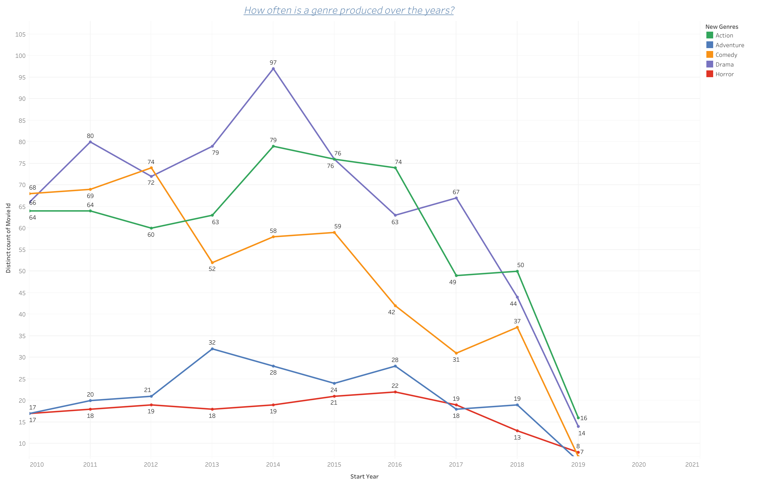
GENRE PRODUCTION OVER TIME
This chart shows growth or decline in production.
Drama and action are the most produced genre over the years
Action having an average profit of 129,280,692.
Drama having an average of profit of 31,739,009.
In comparison o Fantasy that has most profit of 208,985,888,action is a good genre to consider.

Slide 9
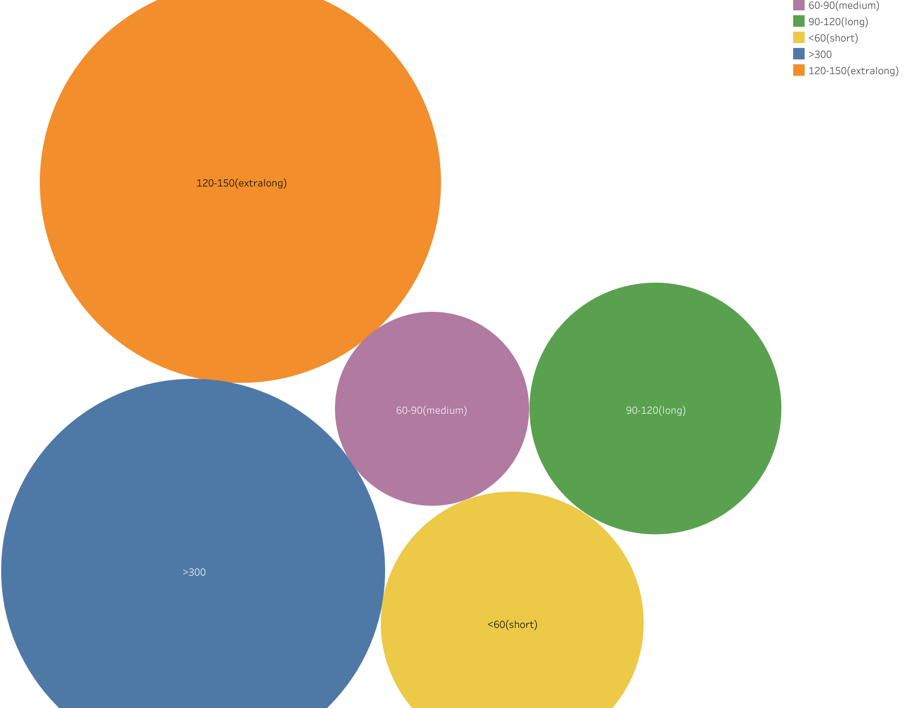
DOES RUNTIME AFFECT RATING?
Runtime of range 90-120 have a higher rating with an average rating of 9,674.
followed by the 60-90 range ,with an average rating of 3,825. This is closely followed by the 120-150 range with an average rating of 2,538.
Less than or equal to 60 minutes appears to have the lowest rating.
Thus, suggesting higher runtime movies have higher ratings.

Slide 10
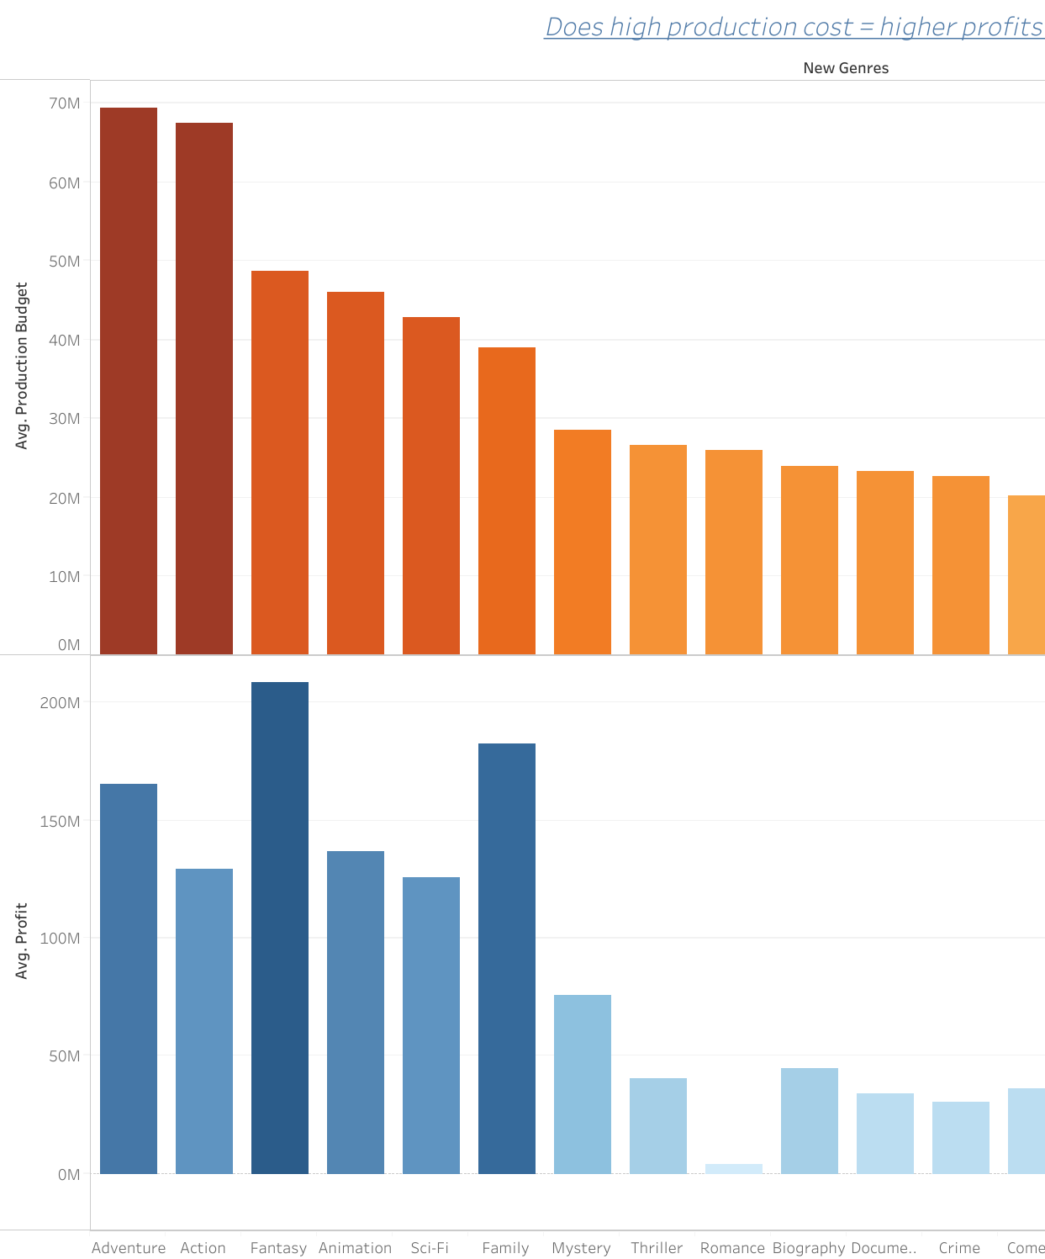
DOES HIGH PRODUCTION_BUDGET =HIGH PROFIT?
Most of the genre with a higher production cost ,have high profits
While lower production cost equal less profit and in some cases loss or no profit.
But this does not necessarily indicate that a higher production cost corresponds to higher profits
Genre | Production_Budget | Avg.profit
Fantasy | 49,710,000 | 208,985,888
Adventure | 69,416,310 | 165,416,072
Musical | 12,8000,000 | 6,548,295
History | 500,000 | -500,000

Slide 11
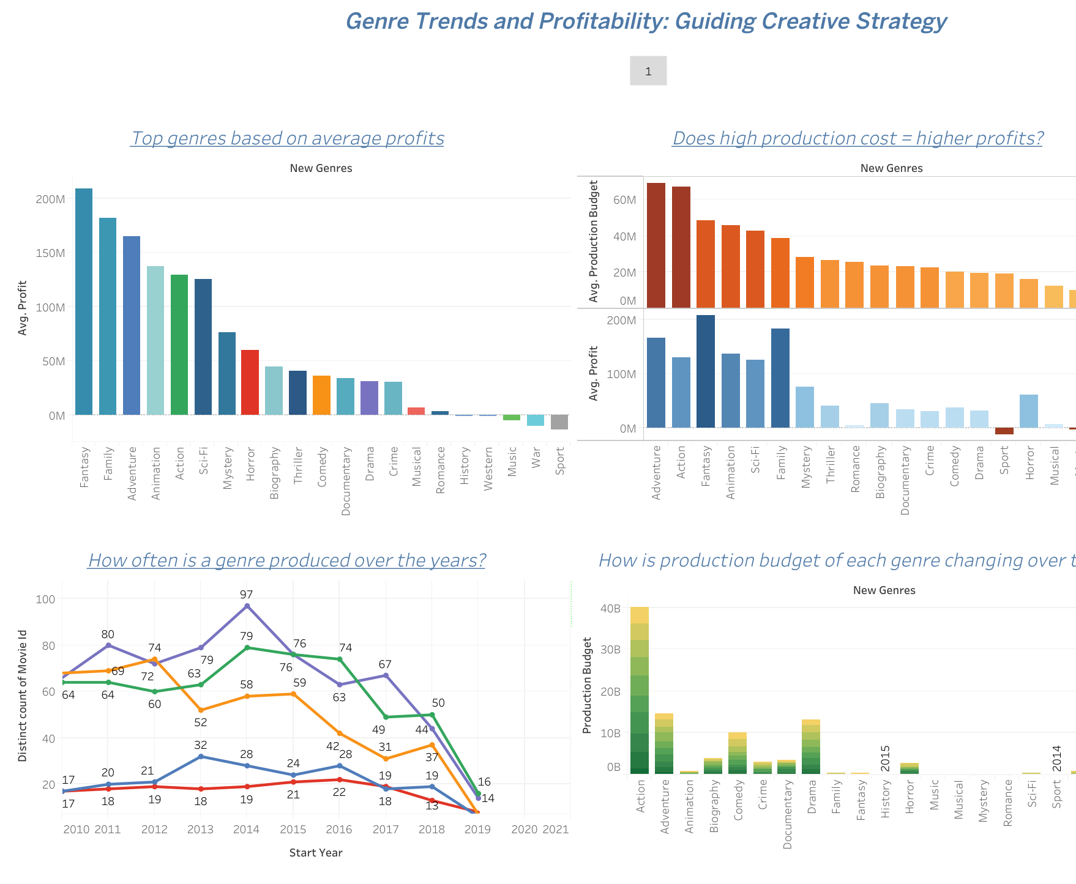
GENRE TRENDS AND PROFITABILITY
The focus is to understand genre and production, the top genres .
Over the years,3 genres have stood out in the production but steadily the gap is closing among the top 5 genres produced.
Although Fantasy is not among the top 5 most produced genres it has the most profit generated .
Production budget varies over the years.
Taking a deeper look in the year 2016 ,the production budget for Action was 4,990,550,000 while in 2019 recording the lowest production budget of 1,573,500,00

Slide 12
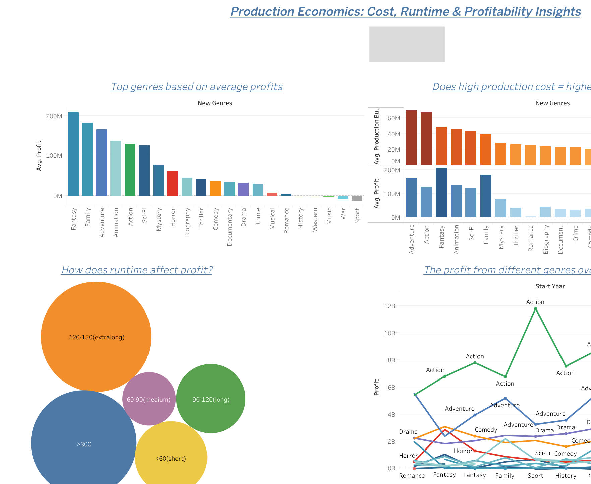
PRODUCTION ECONOMICS
What is my budget?
To create the films, we analyzed the various genre production budget and the corresponding profit.
From the findings a higher production budget does not really corresponds to higher profits.
The runtime also affects profits,shorter runtime of 60 or less minutes have relatively smaller profits.

Slide 13

RECOMMENDATIONS
Focus on genres that are showing a growth in production, and generating a higher profit consider: drama, Fantasy, Action and other genres that have high production rate.
Since this is only the start focus on movies with high average profit and moderate production cost.
Ratings being a major feedback from the consumers, we want to give them what they want, avoid movies that have lower ratings.
consider the 90-120 runtime and avoid creating movies with a short runtime in minutes.
Fantasy being one of the major profitable genres and the production is also relatively lower .It provides a good opportunity to dive into.
Do more research on the production budget in 2019 and 2016 to see what caused the prices to differ greatly in those 2 years.
Continue to monitor the trends in production and feedback from the audience:ratings,numvote and also the genres.
Avoid high-cost genres with uncertain return. Even though action falls among the top profitable genres it is steadily dropping in terms of profit.

Slide 14
NEXT STEPS
What is your budget? Based on this, pick one of the most profitable genres based on this analysis.
.Consider monitoring audience trends over time ,at least twice a year.
Do you have enough expertise and tools required in movie creation?
Take note of why production budget varies in different years for a genre.

Slide 15
THANKYOU

